Slide 1
EE2211 Tutorial 4
(remember to sign your attendance on the sheet of paper)

Slide 2
Lecture recap

Slide 3
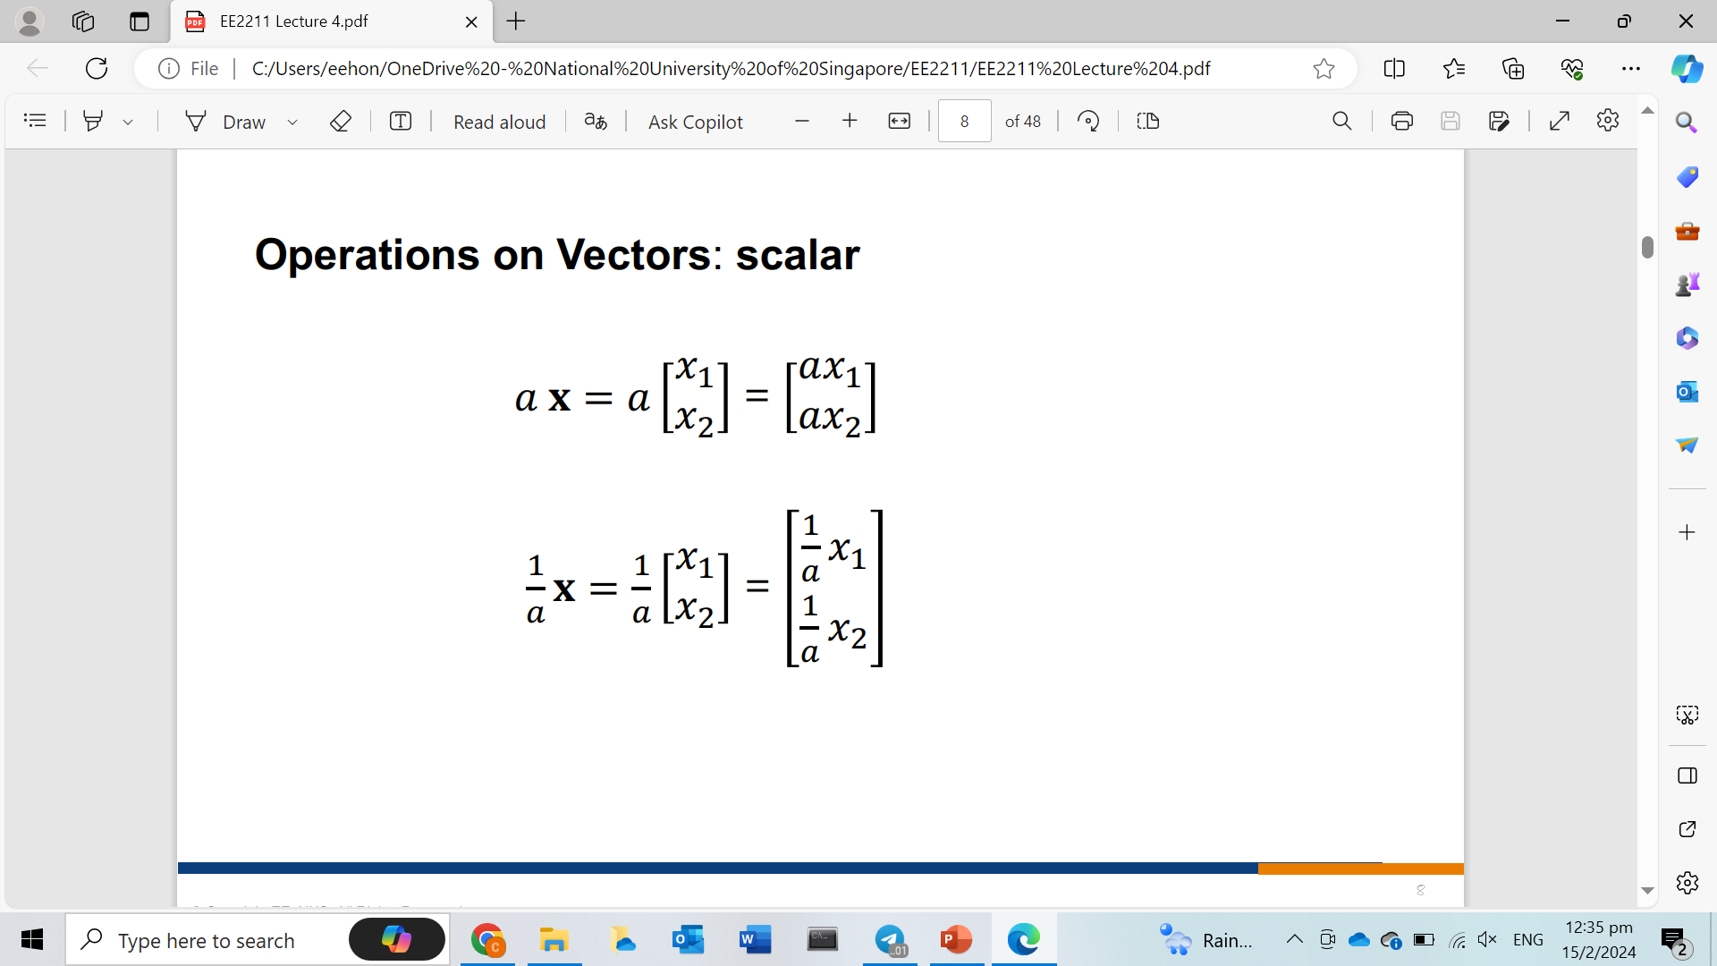
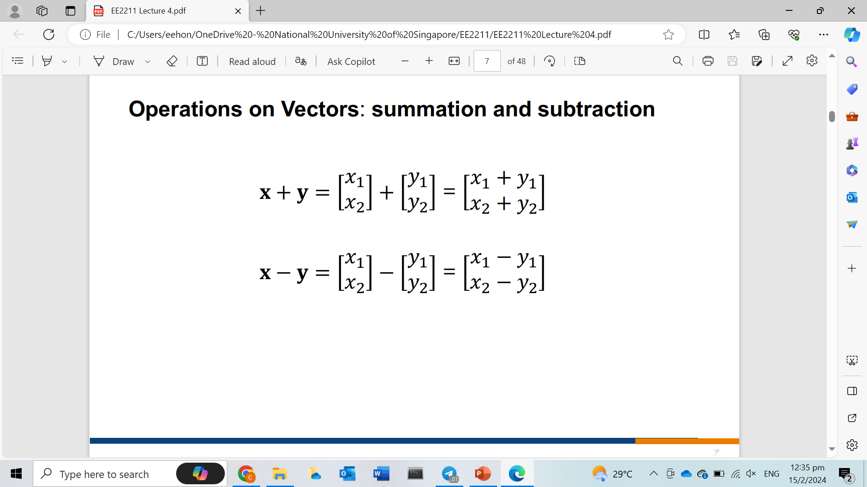
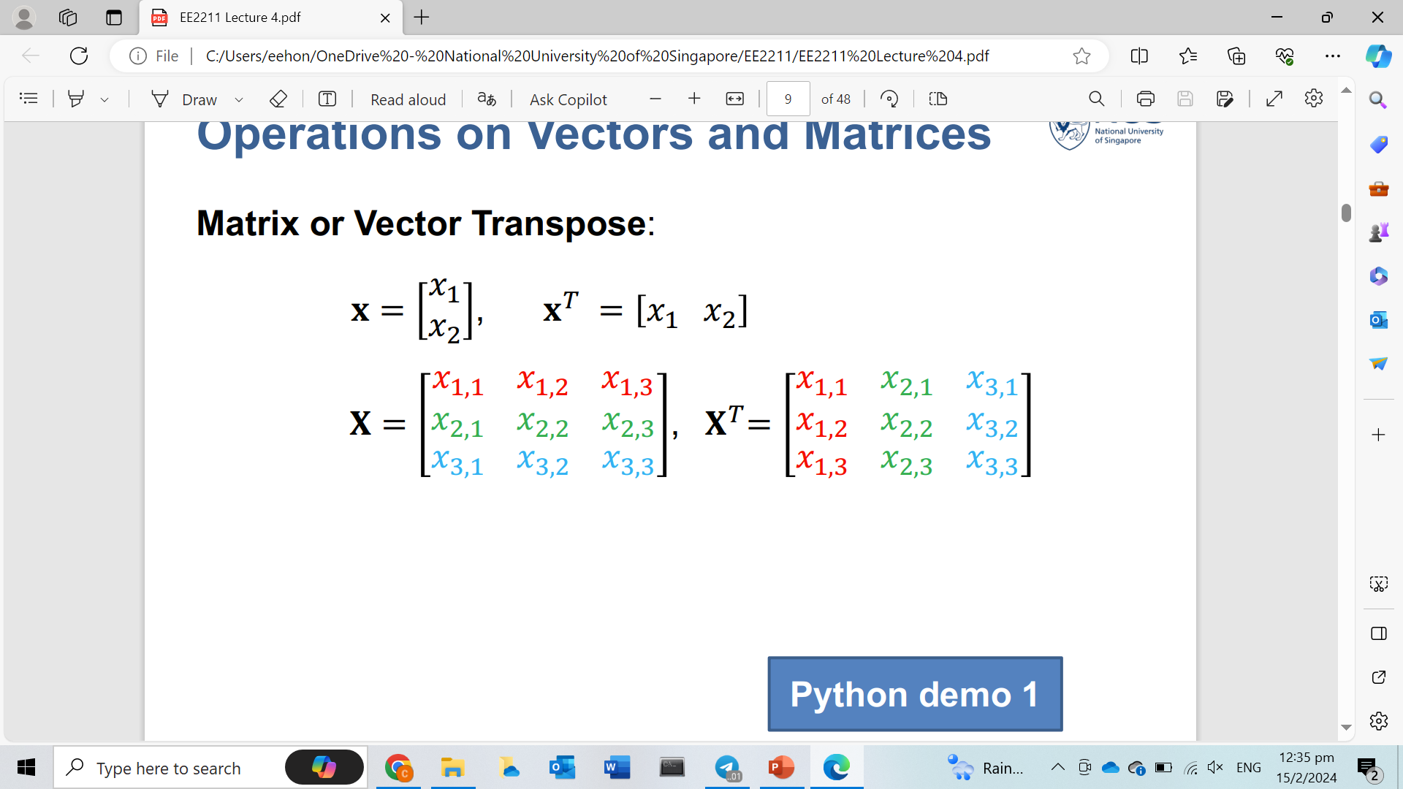
Matrix operations

Slide 4
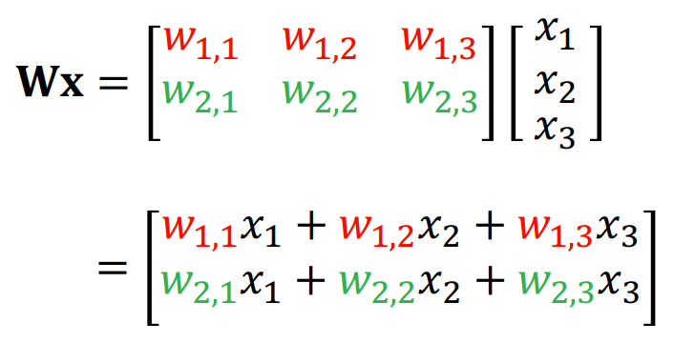
Matrix operations
If matrix X is (2 rows x 3 columns) and matrix Y is (3 rows x 1 column),
the result is matrix Z (2 rows x 1 column)

Slide 5
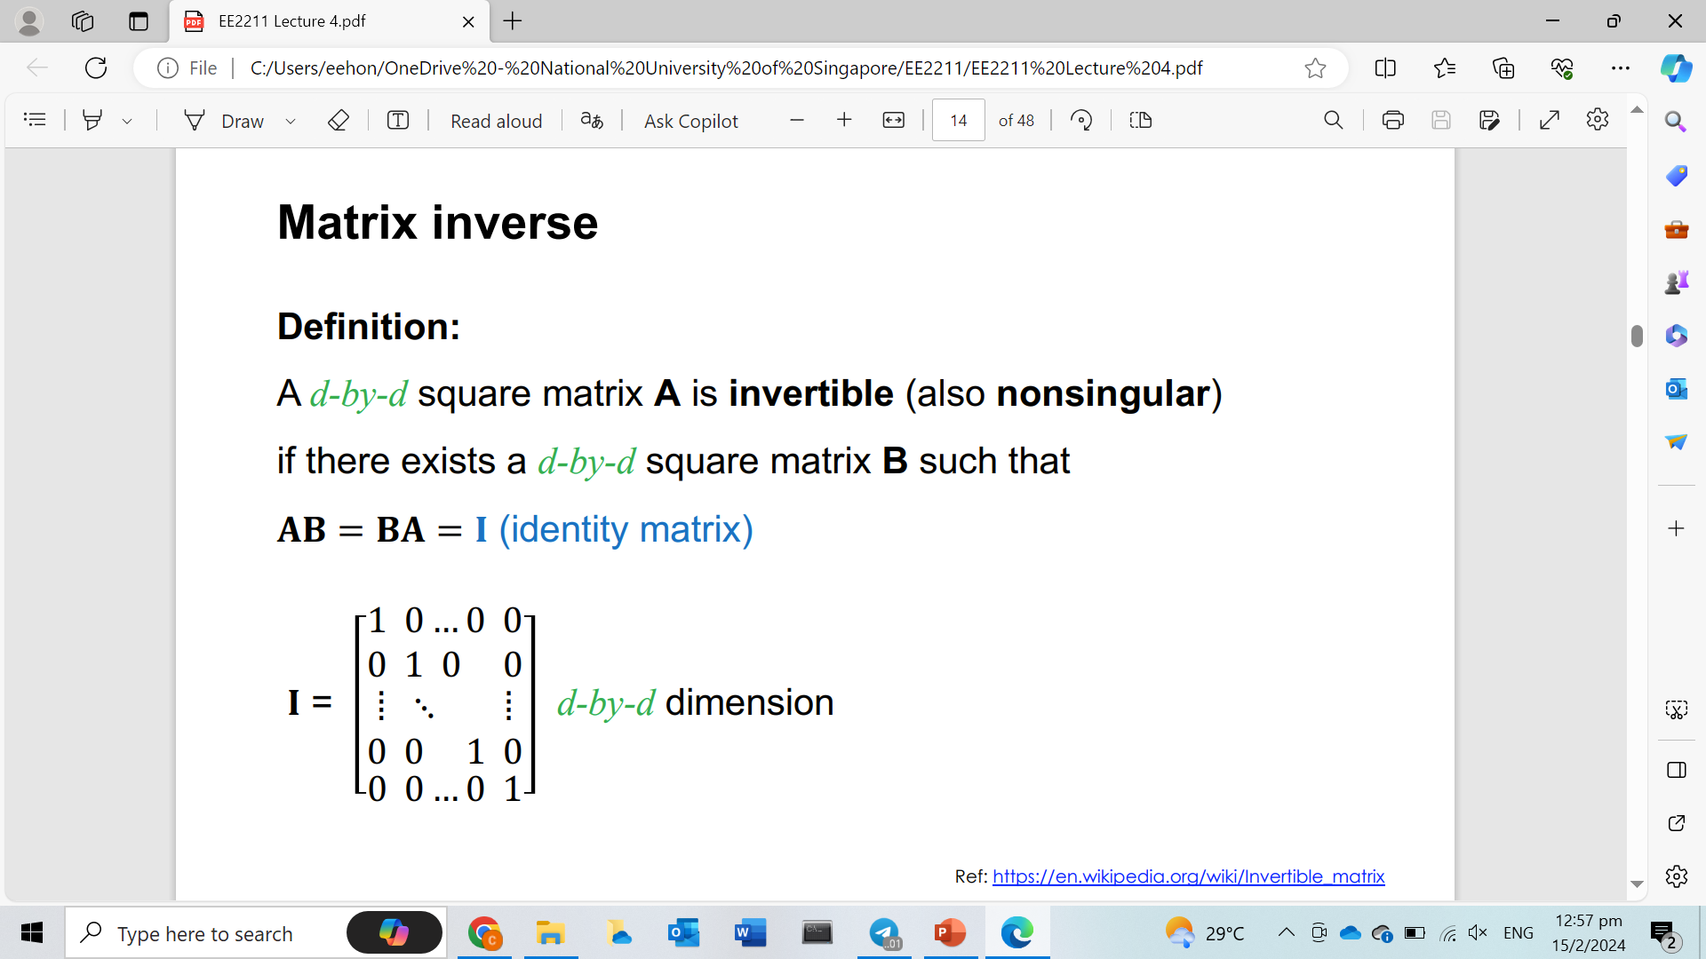
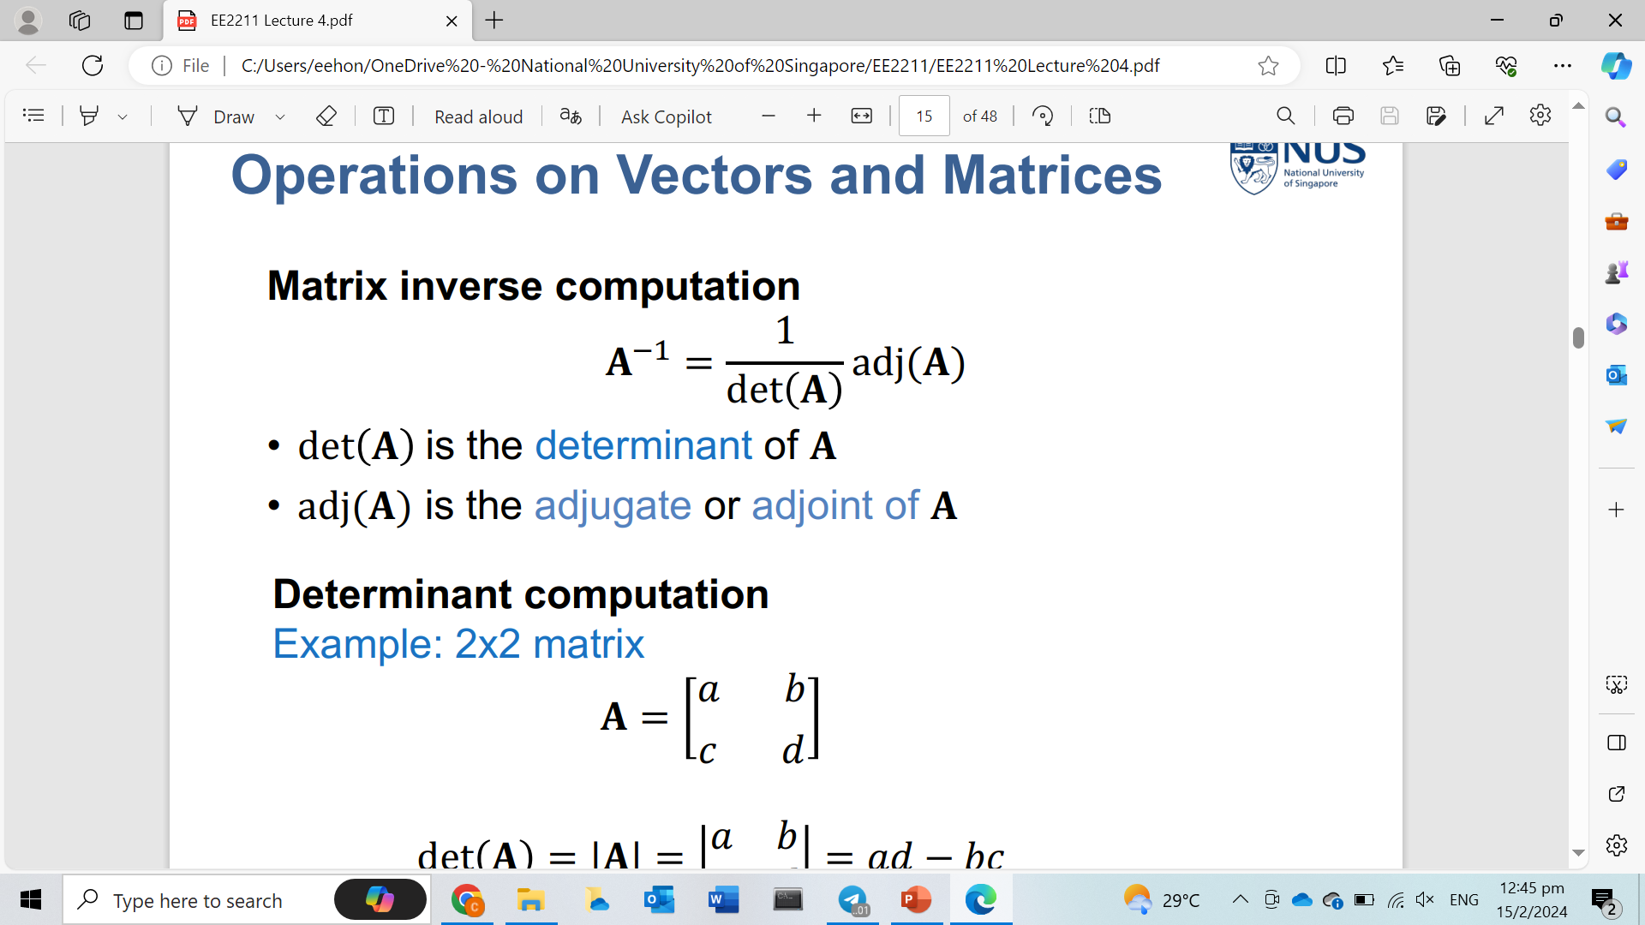
Matrix Inverse

Slide 6
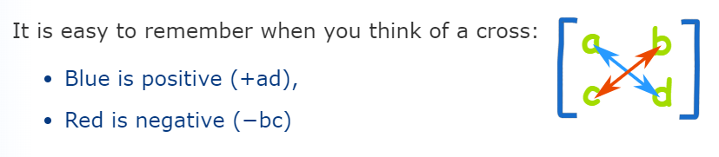
Matrix Determinant
Determinant for 2x2 matrix = ad - bc

Slide 7
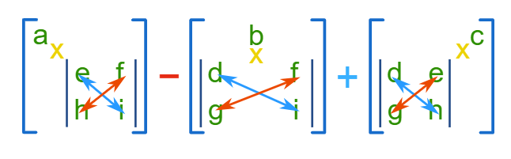
Matrix Determinant
Determinant for 3x3 matrix = a(ei - hf) – b(di - gf) + c(dh - ge)

Slide 8
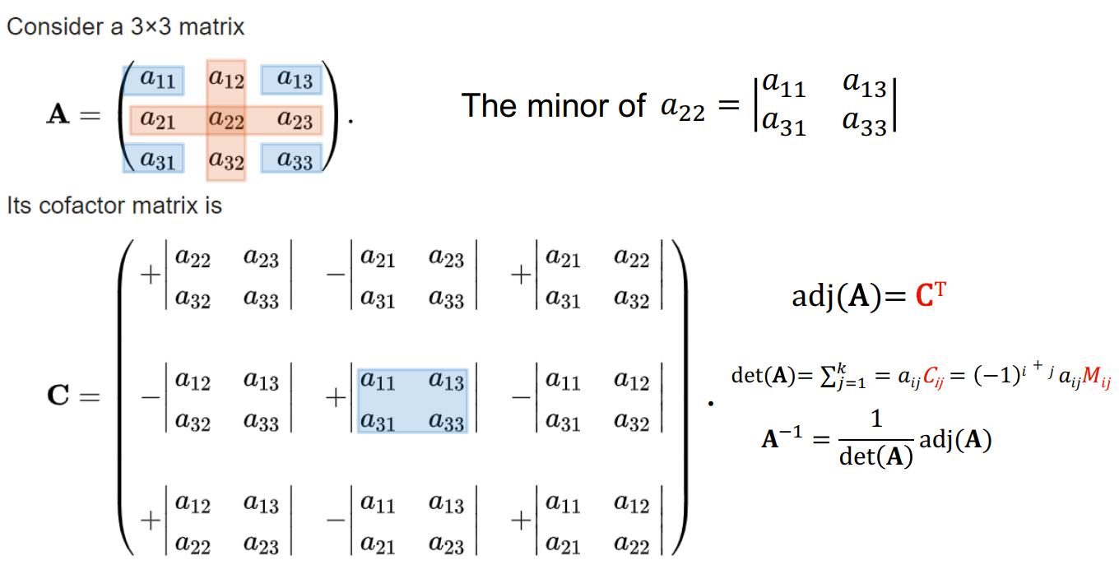
Matrix Adjugate

Slide 9
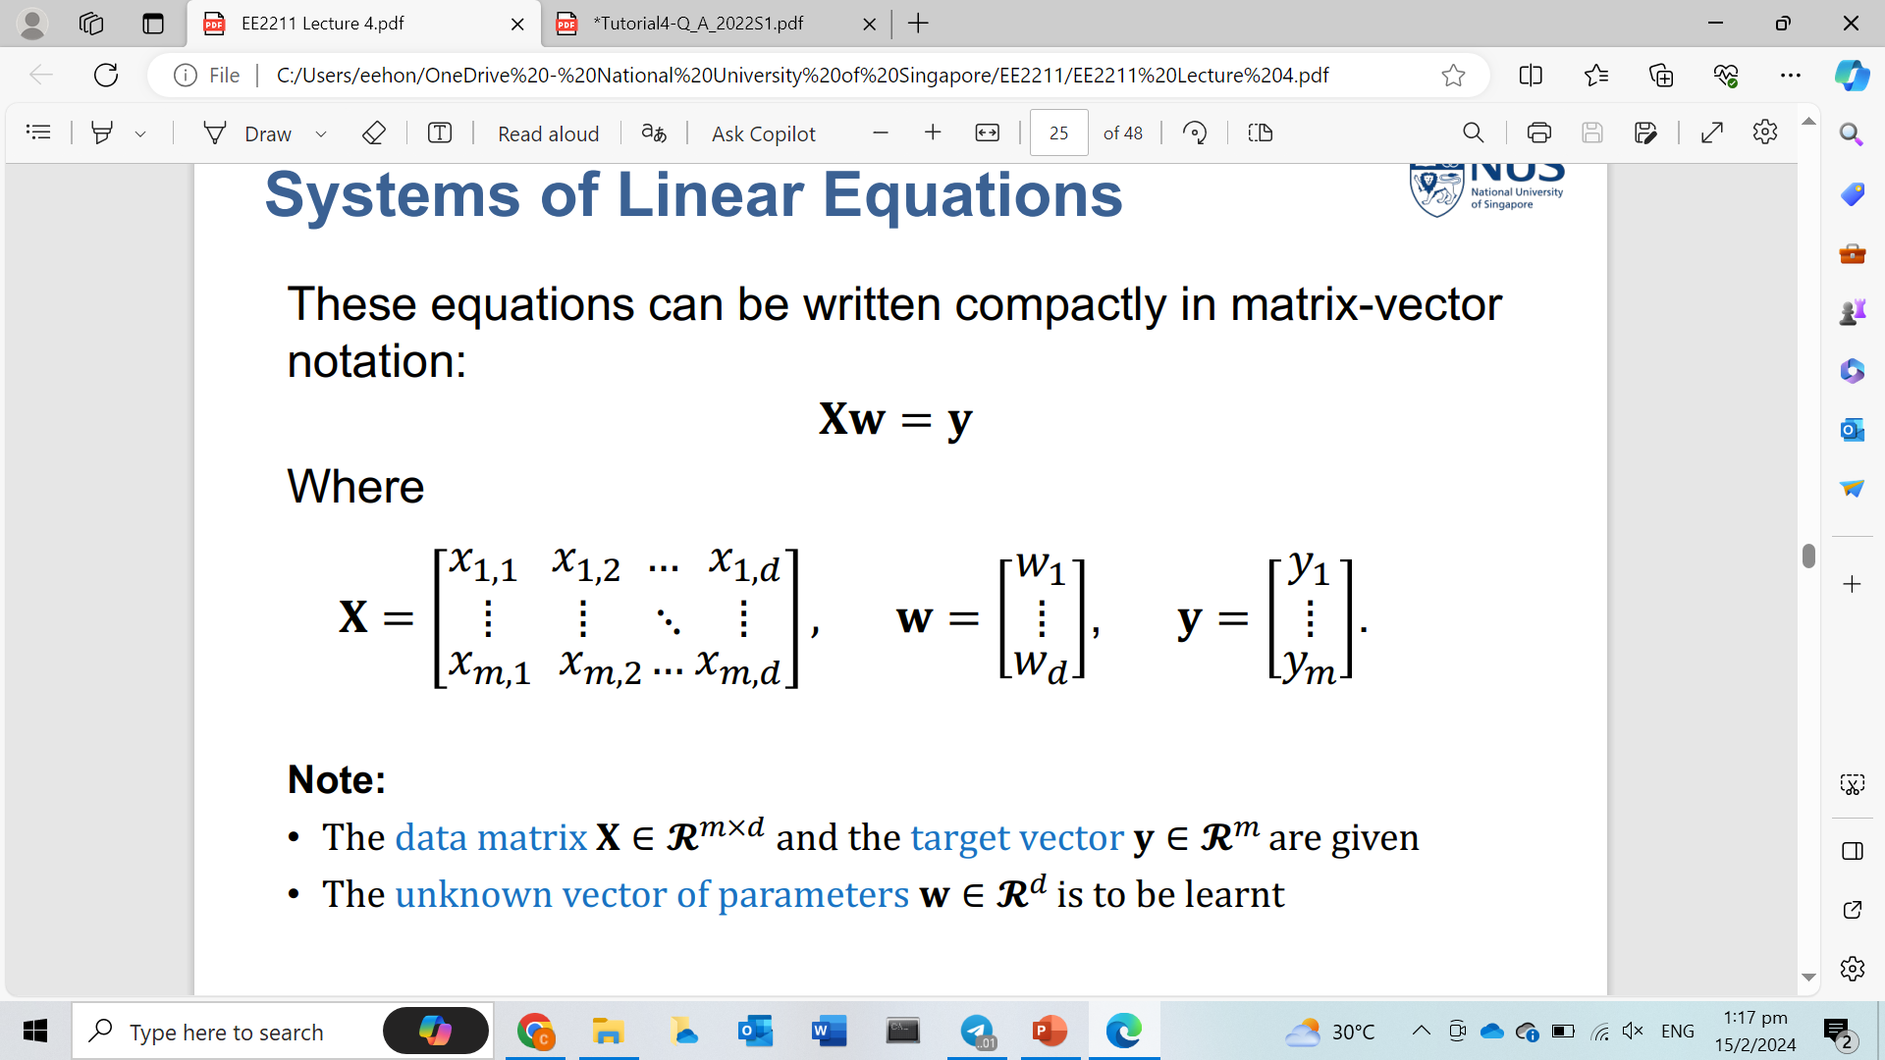
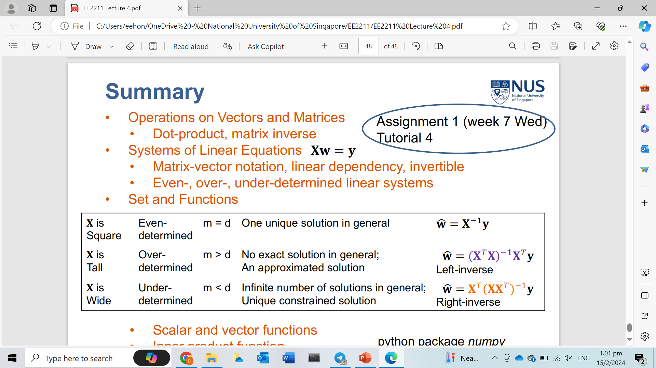
System of linear equations
w and y must be in this form!

Slide 10
Tutorial 4

Slide 11
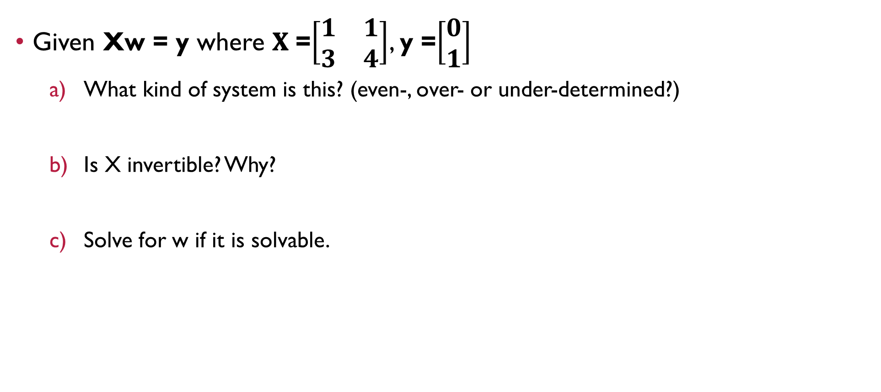
Question 1
Given Xw = y where 𝐗 =$\left[\begin{matrix}1 & 1 \\ 3 & 4\end{matrix}\right]$, y =$\left[\begin{matrix}0 \\ 1\end{matrix}\right]$
What kind of system is this? (even-, over- or under-determined?)
Is X invertible? Why?
Solve for w if it is solvable.

Slide 12
Question 1
Given Xw = y where 𝐗 =$\left[\begin{matrix}1 & 1 \\ 3 & 4\end{matrix}\right]$, y =$\left[\begin{matrix}0 \\ 1\end{matrix}\right]$
What kind of system is this? (even-, over- or under-determined?)
Is X invertible? Why?
Solve for w if it is solvable.
Even determined

Slide 13
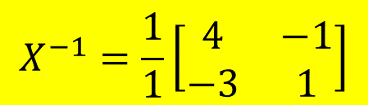
Question 1
Given Xw = y where 𝐗 =$\left[\begin{matrix}1 & 1 \\ 3 & 4\end{matrix}\right]$, y =$\left[\begin{matrix}0 \\ 1\end{matrix}\right]$
What kind of system is this? (even-, over- or under-determined?)
Is X invertible? Why?
Solve for w if it is solvable.
Even determined
$$X^{−1}=\frac{1}{1}\left[\begin{matrix}4 & −1 \\ −3 & 1\end{matrix}\right]$$
det(X) = 1⨯4 – 1⨯3 = 1≠0

Slide 14
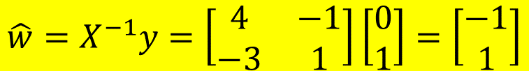
Question 1
Given Xw = y where 𝐗 =$\left[\begin{matrix}1 & 1 \\ 3 & 4\end{matrix}\right]$, y =$\left[\begin{matrix}0 \\ 1\end{matrix}\right]$
What kind of system is this? (even-, over- or under-determined?)
Is X invertible? Why?
Solve for w if it is solvable.
Even determined
$$X^{−1}=\frac{1}{1}\left[\begin{matrix}4 & −1 \\ −3 & 1\end{matrix}\right]$$
det(X) = 1⨯4 – 1⨯3 = 1≠0
$$\hat{w}=X^{−1}y=\left[\begin{matrix}4 & −1 \\ −3 & 1\end{matrix}\right]\left[\begin{matrix}0 \\ 1\end{matrix}\right]=\left[\begin{matrix}−1 \\ 1\end{matrix}\right]$$

Slide 15

Question 2
Given Xw = y where 𝐗 =$\left[\begin{matrix}1 & 2 \\ 3 & 6\end{matrix}\right]$, y =$\left[\begin{matrix}0 \\ 1\end{matrix}\right]$
What kind of system is this? (even-, over- or under-determined?)
Is X invertible? Why?
Solve for w if it is solvable.

Slide 16
Question 2
Given Xw = y where 𝐗 =$\left[\begin{matrix}1 & 2 \\ 3 & 6\end{matrix}\right]$, y =$\left[\begin{matrix}0 \\ 1\end{matrix}\right]$
What kind of system is this? (even-, over- or under-determined?)
Is X invertible? Why?
Solve for w if it is solvable.
Even determined

Slide 17
Question 2
Given Xw = y where 𝐗 =$\left[\begin{matrix}1 & 2 \\ 3 & 6\end{matrix}\right]$, y =$\left[\begin{matrix}0 \\ 1\end{matrix}\right]$
What kind of system is this? (even-, over- or under-determined?)
Is X invertible? Why?
Solve for w if it is solvable.
Even determined
X is NOT invertible since the determinant of X=1⨯6 – 2⨯3 = 0

Slide 18
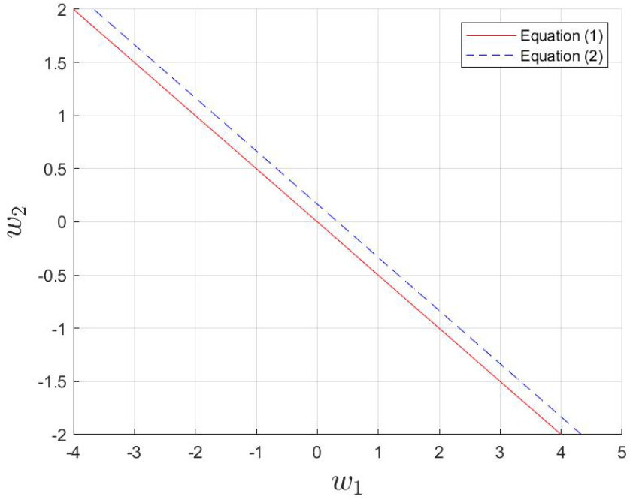
Question 2
Given Xw = y where 𝐗 =$\left[\begin{matrix}1 & 2 \\ 3 & 6\end{matrix}\right]$, y =$\left[\begin{matrix}0 \\ 1\end{matrix}\right]$
What kind of system is this? (even-, over- or under-determined?)
Is X invertible? Why?
Solve for w if it is solvable.
Even determined
X is NOT invertible since the determinant of X=1⨯6 – 2⨯3 = 0
There is no solution for w since the rows/columns of X are inter-dependent. The two lines shown in the plot are parallel and has no intersection.

Slide 19
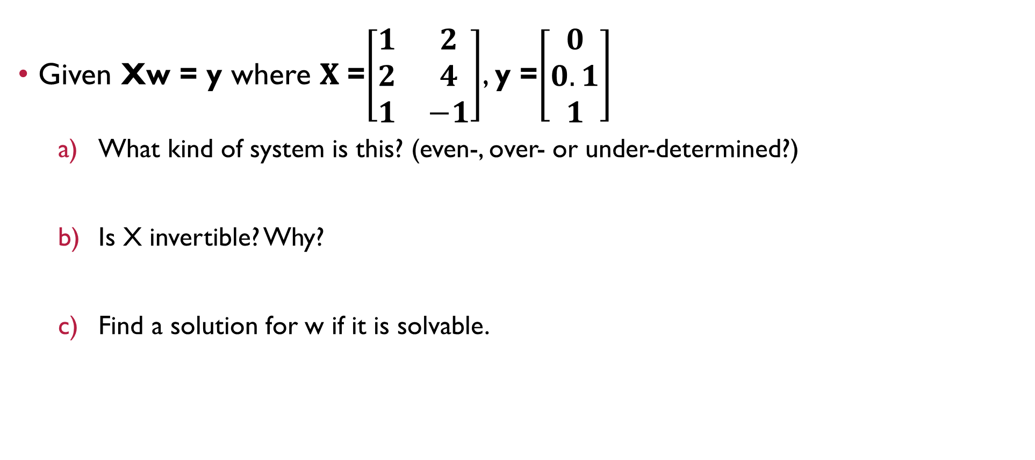
Question 3
Given Xw = y where 𝐗 =$\left[\begin{matrix}1 & 2 \\ 2 & 4 \\ 1 & −1\end{matrix}\right]$, y =$\left[\begin{matrix}0 \\ 0.1 \\ 1\end{matrix}\right]$
What kind of system is this? (even-, over- or under-determined?)
Is X invertible? Why?
Find a solution for w if it is solvable.

Slide 20
Question 3
Given Xw = y where 𝐗 =$\left[\begin{matrix}1 & 2 \\ 2 & 4 \\ 1 & −1\end{matrix}\right]$, y =$\left[\begin{matrix}0 \\ 0.1 \\ 1\end{matrix}\right]$
What kind of system is this? (even-, over- or under-determined?)
Is X invertible? Why?
Find a solution for w if it is solvable.
Over determined

Slide 21
Question 3
Given Xw = y where 𝐗 =$\left[\begin{matrix}1 & 2 \\ 2 & 4 \\ 1 & −1\end{matrix}\right]$, y =$\left[\begin{matrix}0 \\ 0.1 \\ 1\end{matrix}\right]$
What kind of system is this? (even-, over- or under-determined?)
Is X invertible? Why?
Find a solution for w if it is solvable.
Over determined
X is NOT invertible but $X^{T}X=\left[\begin{matrix}6 & 9 \\ 9 & 21\end{matrix}\right]$ is. Determinant of $X^{T}X=6×21−9×9=45$

Slide 22

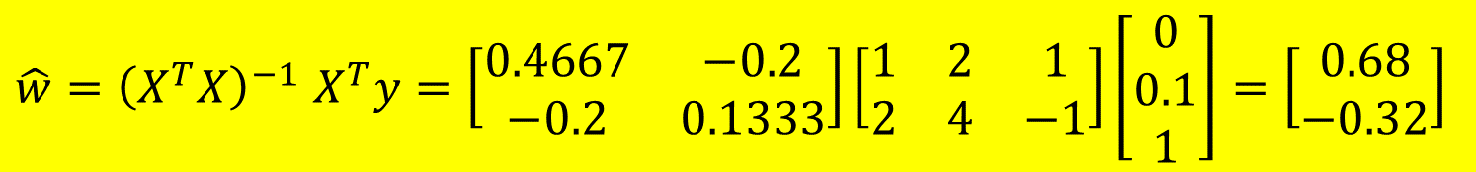
Question 3
Given Xw = y where 𝐗 =$\left[\begin{matrix}1 & 2 \\ 2 & 4 \\ 1 & −1\end{matrix}\right]$, y =$\left[\begin{matrix}0 \\ 0.1 \\ 1\end{matrix}\right]$
What kind of system is this? (even-, over- or under-determined?)
Is X invertible? Why?
Find a solution for w if it is solvable..
Over determined
X is NOT invertible but $X^{T}X=\left[\begin{matrix}6 & 9 \\ 9 & 21\end{matrix}\right]$ is. Determinant of $X^{T}X=6×21−9×9=45$
$\hat{w}={\left(X^{T}X\right)}^{−1}$ $X^{T}y=\left[\begin{matrix}0.4667 & −0.2 \\ −0.2 & 0.1333\end{matrix}\right]\left[\begin{matrix}1 & 2 & 1 \\ 2 & 4 & −1\end{matrix}\right]\left[\begin{matrix}0 \\ 0.1 \\ 1\end{matrix}\right]=\left[\begin{matrix}0.68 \\ −0.32\end{matrix}\right]$

Slide 23
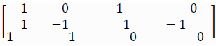
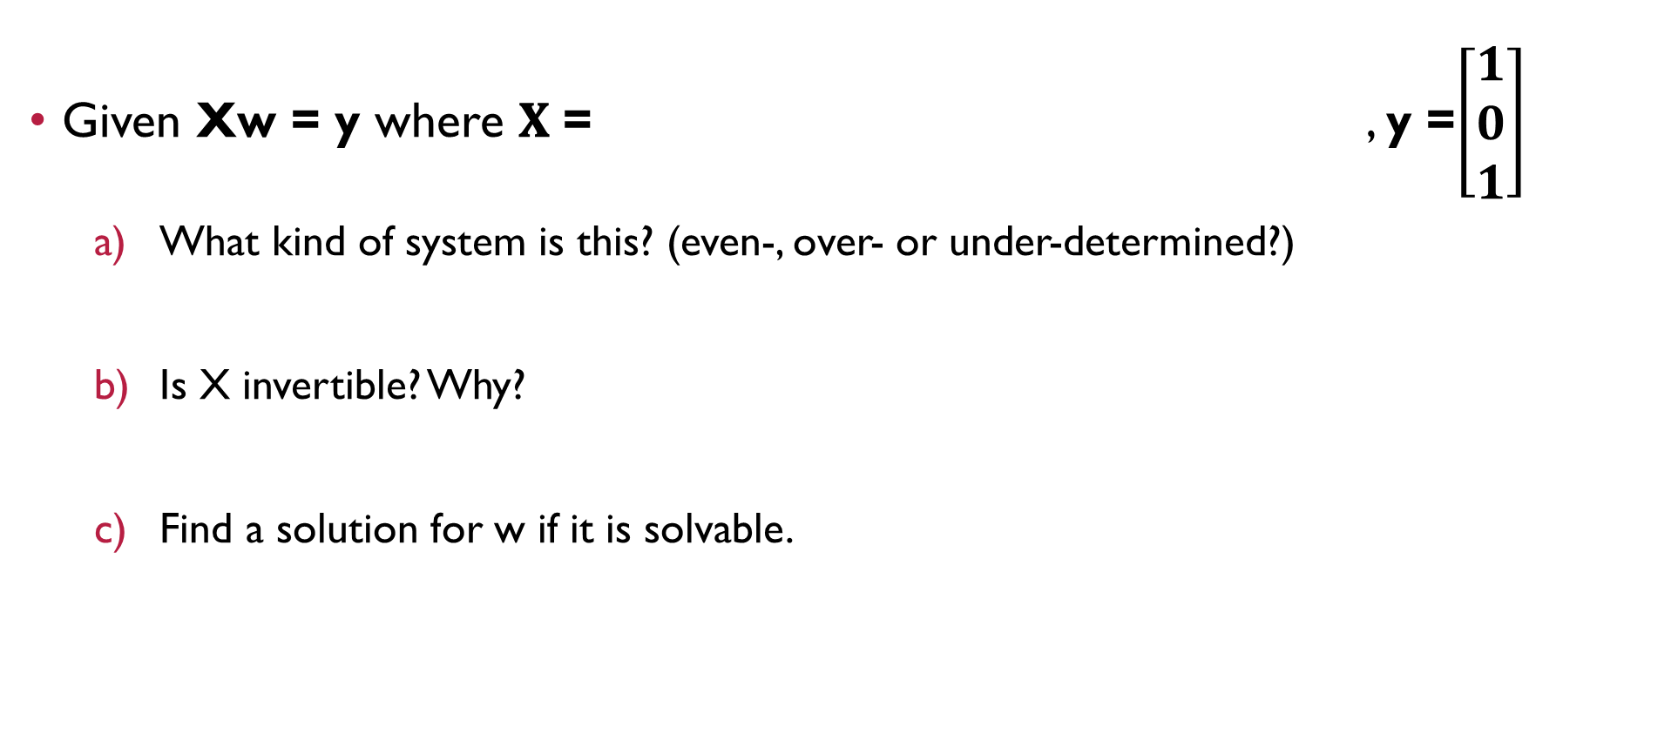
Question 4
Given Xw = y where 𝐗 = , y =$\left[\begin{matrix}1 \\ 0 \\ 1\end{matrix}\right]$
What kind of system is this? (even-, over- or under-determined?)
Is X invertible? Why?
Find a solution for w if it is solvable.

Slide 24
Question 4
Given Xw = y where 𝐗 = , y =$\left[\begin{matrix}1 \\ 0 \\ 1\end{matrix}\right]$
What kind of system is this? (even-, over- or under-determined?)
Is X invertible? Why?
Find a solution for w if it is solvable.
Under determined

Slide 25
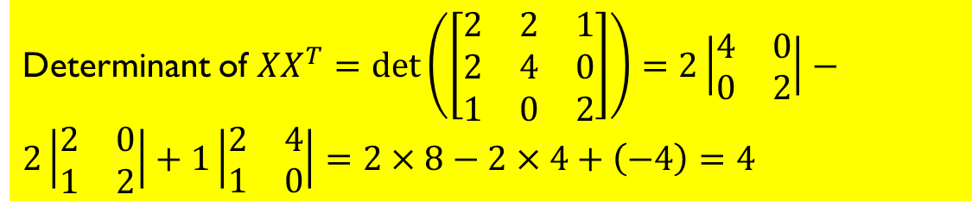

Question 4
Given Xw = y where 𝐗 = , y =$\left[\begin{matrix}1 \\ 0 \\ 1\end{matrix}\right]$
What kind of system is this? (even-, over- or under-determined?)
Is X invertible? Why?
Find a solution for w if it is solvable.
Under determined
Determinant of ${XX}^{T}=det\left(\left[\begin{matrix}2 & 2 & 1 \\ 2 & 4 & 0 \\ 1 & 0 & 2\end{matrix}\right]\right)=2\left|\begin{matrix}4 & 0 \\ 0 & 2\end{matrix}\right|−2\left|\begin{matrix}2 & 0 \\ 1 & 2\end{matrix}\right|+1\left|\begin{matrix}2 & 4 \\ 1 & 0\end{matrix}\right|=2×8−2×4+\left(−4\right)=4$
X is not but ${XX}^{T}$ is.

Slide 26
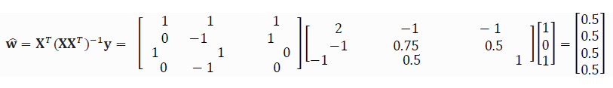
Question 4
Given Xw = y where 𝐗 = , y =$\left[\begin{matrix}1 \\ 0 \\ 1\end{matrix}\right]$
What kind of system is this? (even-, over- or under-determined?)
Is X invertible? Why?
Find a solution for w if it is solvable.
Under determined
Determinant of ${XX}^{T}=det\left(\left[\begin{matrix}2 & 2 & 1 \\ 2 & 4 & 0 \\ 1 & 0 & 2\end{matrix}\right]\right)=2\left|\begin{matrix}4 & 0 \\ 0 & 2\end{matrix}\right|−2\left|\begin{matrix}2 & 0 \\ 1 & 2\end{matrix}\right|+1\left|\begin{matrix}2 & 4 \\ 1 & 0\end{matrix}\right|=2×8−2×4+\left(−4\right)=4$
X is not but ${XX}^{T}$ is.

Slide 27

Question 5
Given $w^{T}X=y^{T}$ where 𝐗 = $\left[\begin{matrix}1 & 2 \\ 3 & 6\end{matrix}\right]$, y =$\left[\begin{matrix}0 \\ 1\end{matrix}\right]$
What kind of system is this? (even-, over- or under-determined?)
Is X invertible? Why?
Solve for w if it is solvable.

Slide 28
Question 5
Given $w^{T}X=y^{T}$ where 𝐗 = $\left[\begin{matrix}1 & 2 \\ 3 & 6\end{matrix}\right]$, y =$\left[\begin{matrix}0 \\ 1\end{matrix}\right]$
What kind of system is this? (even-, over- or under-determined?)
Is X invertible? Why?
Solve for w if it is solvable.
Even determined

Slide 29
Question 5
Given $w^{T}X=y^{T}$ where 𝐗 = $\left[\begin{matrix}1 & 2 \\ 3 & 6\end{matrix}\right]$, y =$\left[\begin{matrix}0 \\ 1\end{matrix}\right]$
What kind of system is this? (even-, over- or under-determined?)
Is X invertible? Why?
Solve for w if it is solvable.
Even determined
X is NOT invertible since the determinant of X = 1⨯6 – 2⨯3 = 0

Slide 30
Question 5
Given $w^{T}X=y^{T}$ where 𝐗 = $\left[\begin{matrix}1 & 2 \\ 3 & 6\end{matrix}\right]$, y =$\left[\begin{matrix}0 \\ 1\end{matrix}\right]$
What kind of system is this? (even-, over- or under-determined?)
Is X invertible? Why?
Solve for w if it is solvable.
Even determined
X is NOT invertible since the determinant of X = 1⨯6 – 2⨯3 = 0
There is no solution for w (two parallel lines).

Slide 31

Question 6
Given $w^{T}X=y^{T}$ where 𝐗 = $\left[\begin{matrix}1 & 2 \\ 2 & 4 \\ 1 & −1\end{matrix}\right]$, y =$\left[\begin{matrix}0 \\ 1\end{matrix}\right]$
What kind of system is this? (even-, over- or under-determined?)
Is X invertible? Why?
Solve for w if it is solvable.

Slide 32

Question 6
Given $w^{T}X=y^{T}$ where 𝐗 = $\left[\begin{matrix}1 & 2 \\ 2 & 4 \\ 1 & −1\end{matrix}\right]$, y =$\left[\begin{matrix}0 \\ 1\end{matrix}\right]$
What kind of system is this? (even-, over- or under-determined?)
Is X invertible? Why?
Solve for w if it is solvable.
Under determined
Transpose both sides to get $X^{T}w=y$

Slide 33

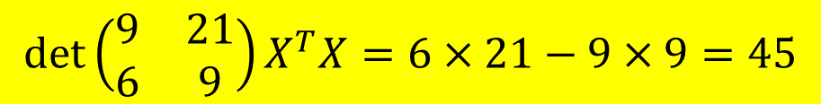
Question 6
Given $w^{T}X=y^{T}$ where 𝐗 = $\left[\begin{matrix}1 & 2 \\ 2 & 4 \\ 1 & −1\end{matrix}\right]$, y =$\left[\begin{matrix}0 \\ 1\end{matrix}\right]$
What kind of system is this? (even-, over- or under-determined?)
Is X invertible? Why?
Solve for w if it is solvable.
Under determined
Transpose both sides to get $X^{T}w=y$
$$\det\left(\begin{matrix}9 & 21 \\ 6 & 9\end{matrix}\right)X^{T}X=6×21−9×9=45$$
X is NOT invertible but $X^{T}X$ is.

Slide 34
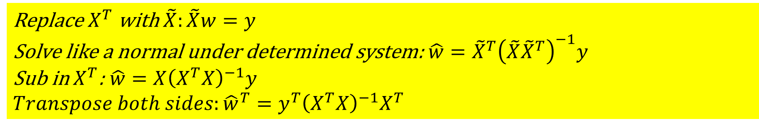
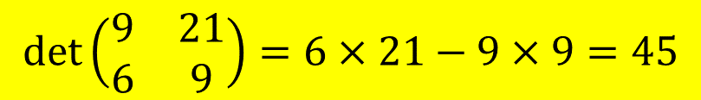
Question 6
Given $w^{T}X=y^{T}$ where 𝐗 = $\left[\begin{matrix}1 & 2 \\ 2 & 4 \\ 1 & −1\end{matrix}\right]$, y =$\left[\begin{matrix}0 \\ 1\end{matrix}\right]$
What kind of system is this? (even-, over- or under-determined?)
Is X invertible? Why?
Solve for w if it is solvable.
Under determined
Transpose both sides to get $X^{T}w=y$
$$\det\left(\begin{matrix}9 & 21 \\ 6 & 9\end{matrix}\right)=6×21−9×9=45$$
X is NOT invertible but $X^{T}X$ is.
Replace $X^{T}$ with $\tilde{X}:\tilde{X}w=y$
Solve like a normal under determined system: $\hat{w}={\tilde{X}}^{T}{\left(\tilde{X}{\tilde{X}}^{T}\right)}^{−1}y$
Sub in $X^{T}$: $\hat{w}=X{\left(X^{T}X\right)}^{−1}y$
$$Transpose both sides:{\hat{w}}^{T}=y^{T}{\left(X^{T}X\right)}^{−1}X^{T}$$
$$\left[\begin{matrix}0 & 1\end{matrix}\right]\left[\begin{matrix}0.4667 & −0.2 \\ −0.2 & 0.1333\end{matrix}\right]\left[\begin{matrix}1 & 2 & 1 \\ 2 & 4 & −1\end{matrix}\right]=\left[\begin{matrix}0.0667 & 0.1333 & −0.3333\end{matrix}\right]$$

Slide 35
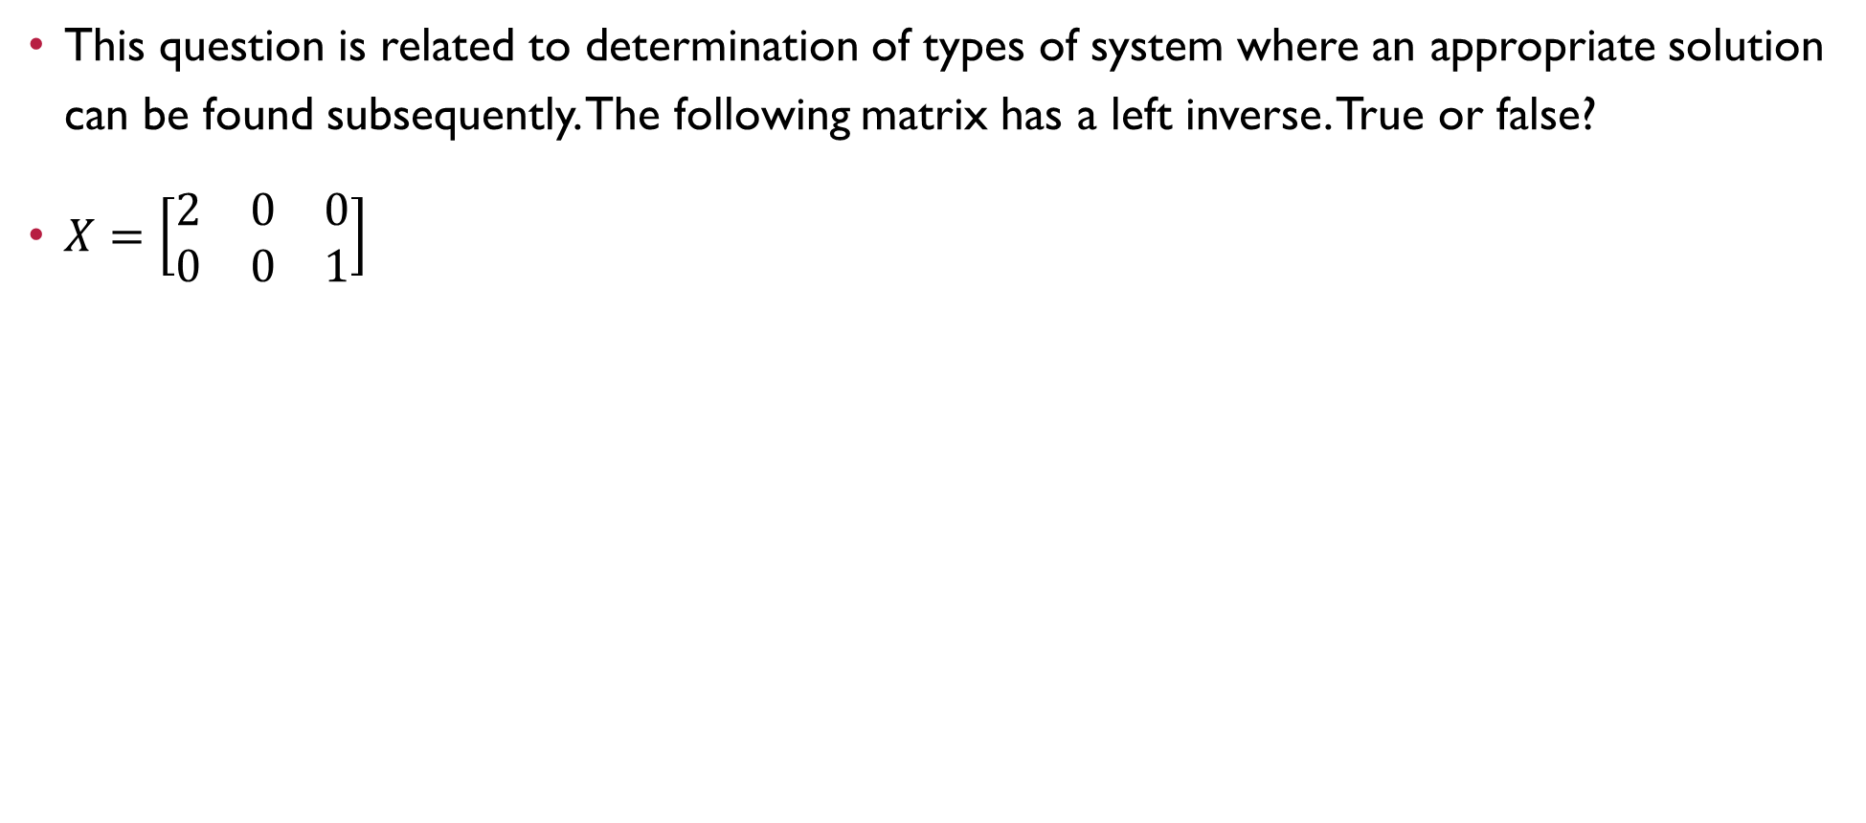
Question 7
This question is related to determination of types of system where an appropriate solution can be found subsequently. The following matrix has a left inverse. True or false?
$X=\left[\begin{matrix}2 & 0 & 0 \\ 0 & 0 & 1\end{matrix}\right]$

Slide 36
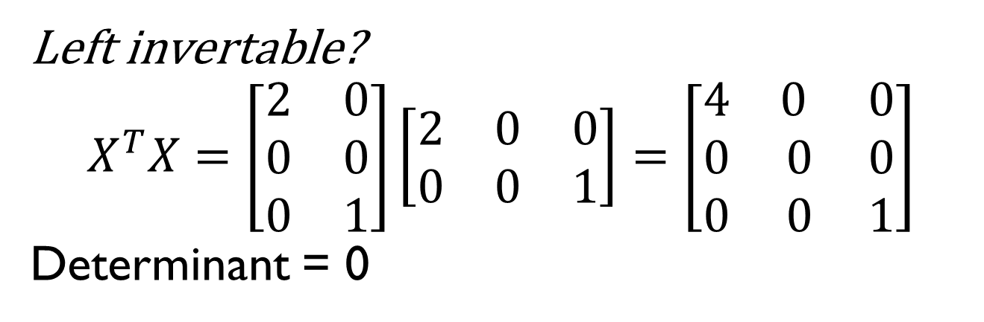
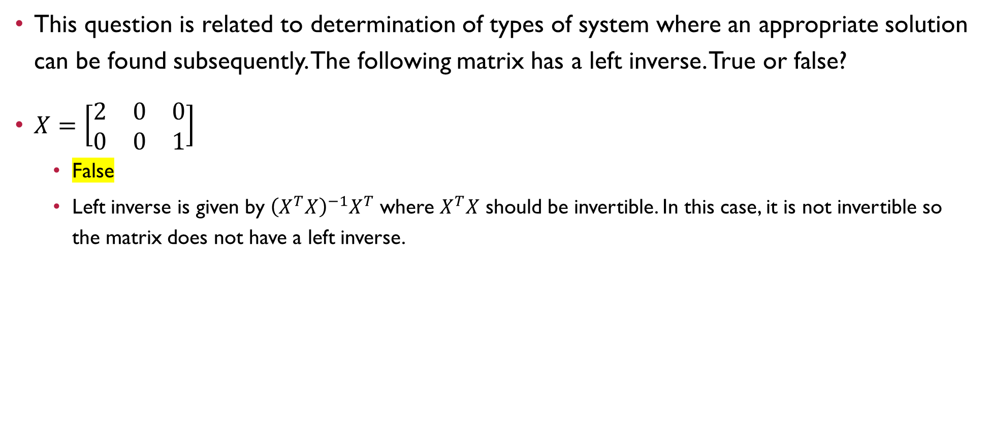
Question 7
This question is related to determination of types of system where an appropriate solution can be found subsequently. The following matrix has a left inverse. True or false?
$X=\left[\begin{matrix}2 & 0 & 0 \\ 0 & 0 & 1\end{matrix}\right]$
False
Left inverse is given by ${\left(X^{T}X\right)}^{−1}X^{T}$ where $X^{T}X$ should be invertible. In this case, it is not invertible so the matrix does not have a left inverse.
Left invertable?
$$X^{T}X=\left[\begin{matrix}2 & 0 \\ 0 & 0 \\ 0 & 1\end{matrix}\right]\left[\begin{matrix}2 & 0 & 0 \\ 0 & 0 & 1\end{matrix}\right]=\left[\begin{matrix}4 & 0 & 0 \\ 0 & 0 & 0 \\ 0 & 0 & 1\end{matrix}\right]$$
Determinant = 0

Slide 37
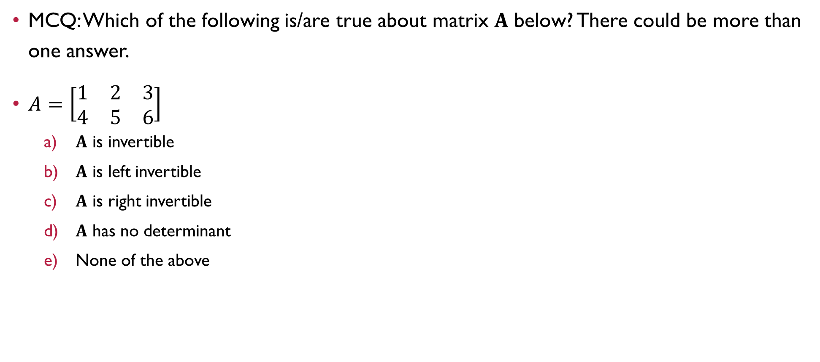
Question 8
MCQ: Which of the following is/are true about matrix 𝐀 below? There could be more than one answer.
$A=\left[\begin{matrix}1 & 2 & 3 \\ 4 & 5 & 6\end{matrix}\right]$
𝐀 is invertible
𝐀 is left invertible
𝐀 is right invertible
𝐀 has no determinant
None of the above

Slide 38
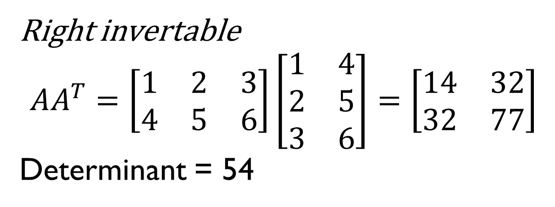
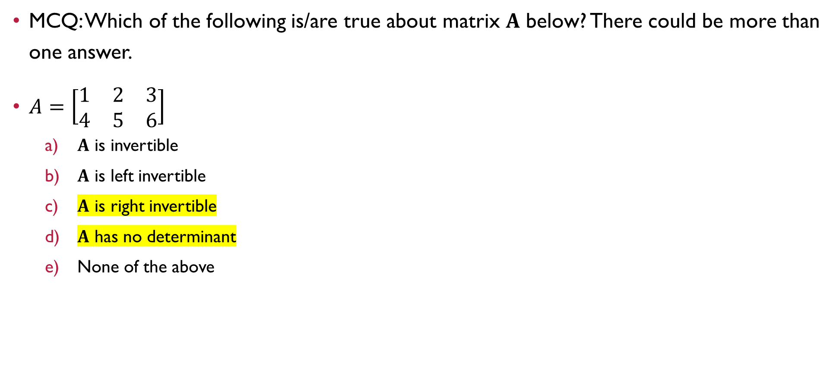
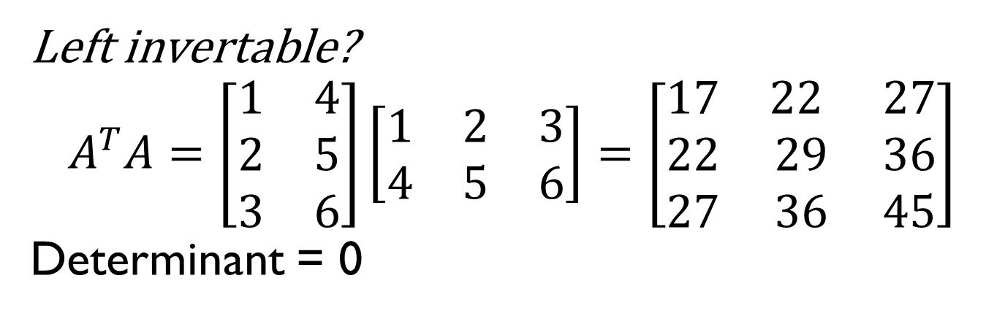
Question 8
MCQ: Which of the following is/are true about matrix 𝐀 below? There could be more than one answer.
$A=\left[\begin{matrix}1 & 2 & 3 \\ 4 & 5 & 6\end{matrix}\right]$
𝐀 is invertible
𝐀 is left invertible
𝐀 is right invertible
𝐀 has no determinant
None of the above
Left invertable?
$$A^{T}A=\left[\begin{matrix}1 & 4 \\ 2 & 5 \\ 3 & 6\end{matrix}\right]\left[\begin{matrix}1 & 2 & 3 \\ 4 & 5 & 6\end{matrix}\right]=\left[\begin{matrix}17 & 22 & 27 \\ 22 & 29 & 36 \\ 27 & 36 & 45\end{matrix}\right]$$
Determinant = 0
Right invertable
$$AA^{T}=\left[\begin{matrix}1 & 2 & 3 \\ 4 & 5 & 6\end{matrix}\right]\left[\begin{matrix}1 & 4 \\ 2 & 5 \\ 3 & 6\end{matrix}\right]=\left[\begin{matrix}14 & 32 \\ 32 & 77\end{matrix}\right]$$
Determinant = 54

Slide 39


Questions?
Feel free to come up to me if you have any questions about anything!
If you are shy, you can use the anonymous form to leave questions & feedback about the tutorial.
You can also reach out to me on our Telegram group or PM me at @eehongchan
Anonymous feedback
Telegram
https://forms.gle/c9QU94YcWjR3EZFk9

